Slide 1
Sentencing
in
Scottish courts

Slide 2
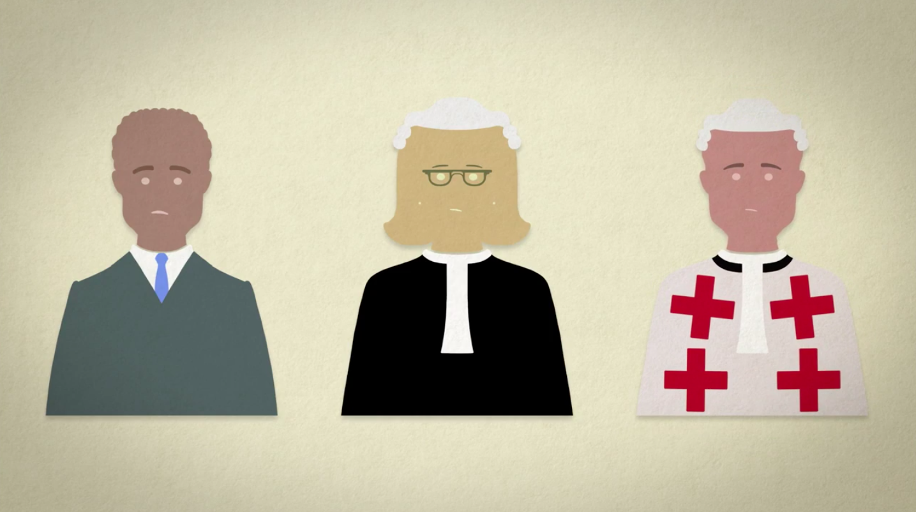

Slide 3
Different Sentences
admonition
fine or compensation order
community payback order (up to 9 different requirements such as unpaid work)
electronic tag
imprisonment
absolute discharge

Slide 4
Different Courts
justice of the peace court
sheriff court
summary case (less serious) solemn cases (more serious)
High Court

Slide 7
High end community payback order
up to 300 hours of unpaid work - equivalent of 6 hours a day for 50 days
years of regular meetings with a social worker aimed at changing offending behaviour
a programme to address an issue such as drug use
compensation payment made to victim

Slide 8
Community Sentences
research shows people see as lenient
however, overall people tend to agree with sentences a sheriff would give in specific case scenarios

Slide 11
The Council
Six judicial members
Three legal members – advocate, solicitor, prosecutor
One police constable
One person with knowledge of victims’ issues
One other person – who is not another judge – currently academic

Slide 12
Developing Guidelines
conduct research - including on guidelines in other jurisdictions
interview judges
look at public perceptions
gather criminal justice data
engage with interest groups
consult widely - including with public
Current consultations are on the Council website

Slide 13
Principles and Purposes guideline (not ordered or exhaustive)
Protection of the public
Punishment
Rehabilitation of offenders
Giving the offender the opportunity to make amends
Expressing disapproval of offending behaviour

Slide 15
Determine seriousness
culpability of offender
harm caused or which could have been caused to victim

Slide 17
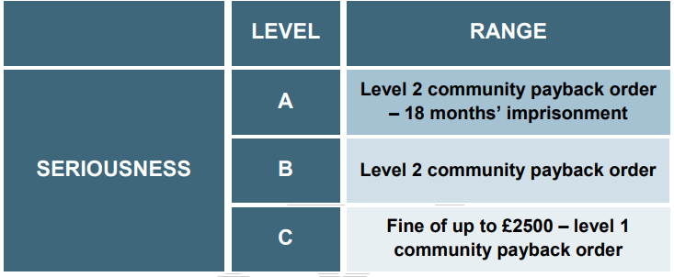

Slide 18
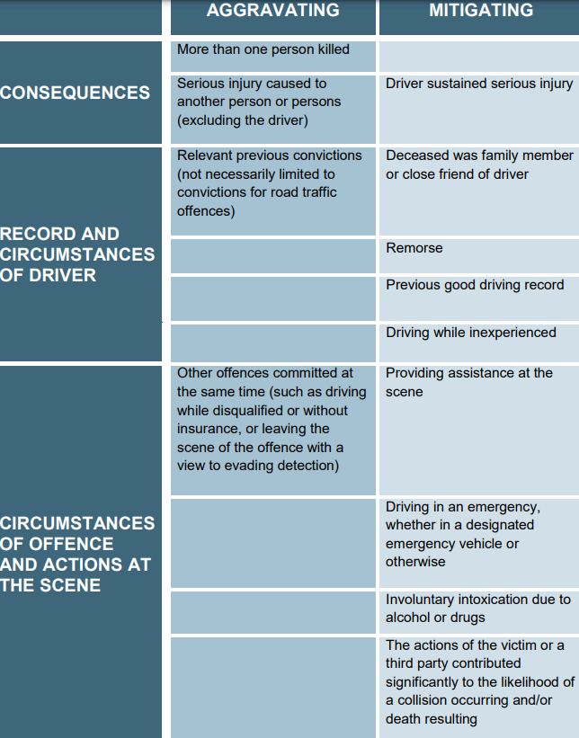

Slide 20
may not have full maturity – leads to lower culpability
may have greater potential to change
Research - young people

Slide 21
Emphasis on rehabilitation
This does not
prevent imprisonment if crime is serious enough
Sentencing young people

Slide 22
Individualised Approach
Take into account
level of maturity
circumstances
background
(impact of trauma and adverse childhood experiences)
Sentencing Young People guideline

Slide 23
imprisonment or community sentence?

Slide 24
community payback order with a requirement for unpaid work of around 250 hours, and disqualified from driving for a year

Slide 25
Difference between initial sentence and final sentence?

Slide 26
what sentences are available to judges
what the law says
interactive case studies where you play the role of judge
series of videos including on sentencing young people
myth and jargon busters
Website
Sentencing young people video

Slide 27
Kahoot Quiz
https://kahoot.it/
Play
Game Pin

Slide 28
Contact us
scottishsentencingcouncil.org.uk
sentencingcouncil@scotcourts.gov.uk
@ScotSentencing / LinkedIn

