Slide 1
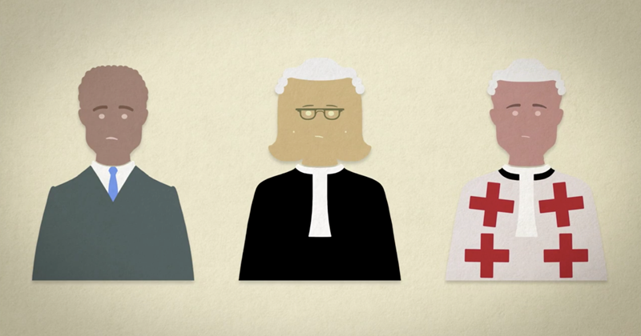
Deciding a Sentence: what a Judge must consider
The offender’s criminal record
The offender has never been in trouble with the law
The offender has been given an admonition before about similar behaviour
The offender has previously completed community service
The offender has been in prison before or a Young Offenders Institution
The circumstances of the offender
The offender cares for an elderly parent
The offender has health problems
The offender just started a college course
The offender is unable to pay a fine
The offender has the means to pay a fine
The extent to which the offender has shown remorse
The offender was sorry for the harm they caused
The offender showed no sign of remorse
Whether the offender has pleaded guilty or not guilty
The offender pleaded guilty
The offender pleaded not guilty
The age and vulnerability of the victim
The victim was a young child
The victim was a pregnant woman
The offender had a disability
The age of the offender
The offender is a teenager
The offender is over 21
The offender is very old
The type of crime committed
The offender was caught speeding
The offender assaulted a victim causing injury
The offender committed murder
Evidence the crime was planned
Evidence shows the crime was planned beforehand
Evidence shows the crime was opportunistic

Slide 2
Drug Offence: Possession of cocaine, a Class A drug, for personal use
Q. Which 3 factors do you think are the most important for the judge to consider when deciding the sentence for the drug offence?
Attempted Murder: the victim was so badly injured they almost died
Q. Which 3 factors do you think are the most important for the judge to consider when deciding the sentence for attempted murder?
Robbery: large sums of money were stolen
Q. Which 3 factors do you think are the most important for the judge to consider when deciding the sentence for robbery?

